Slide 1
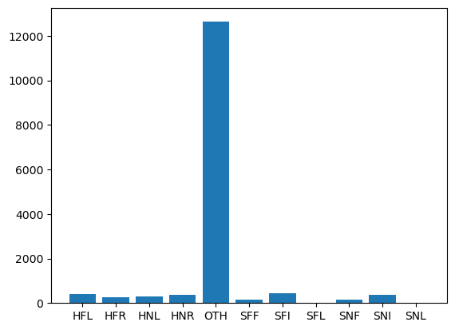
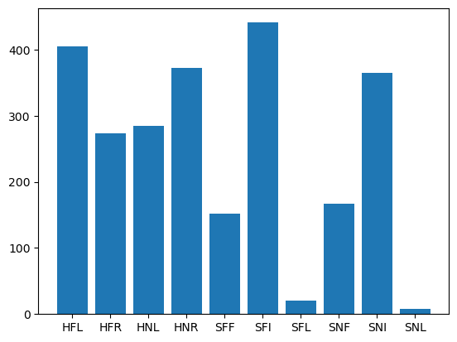
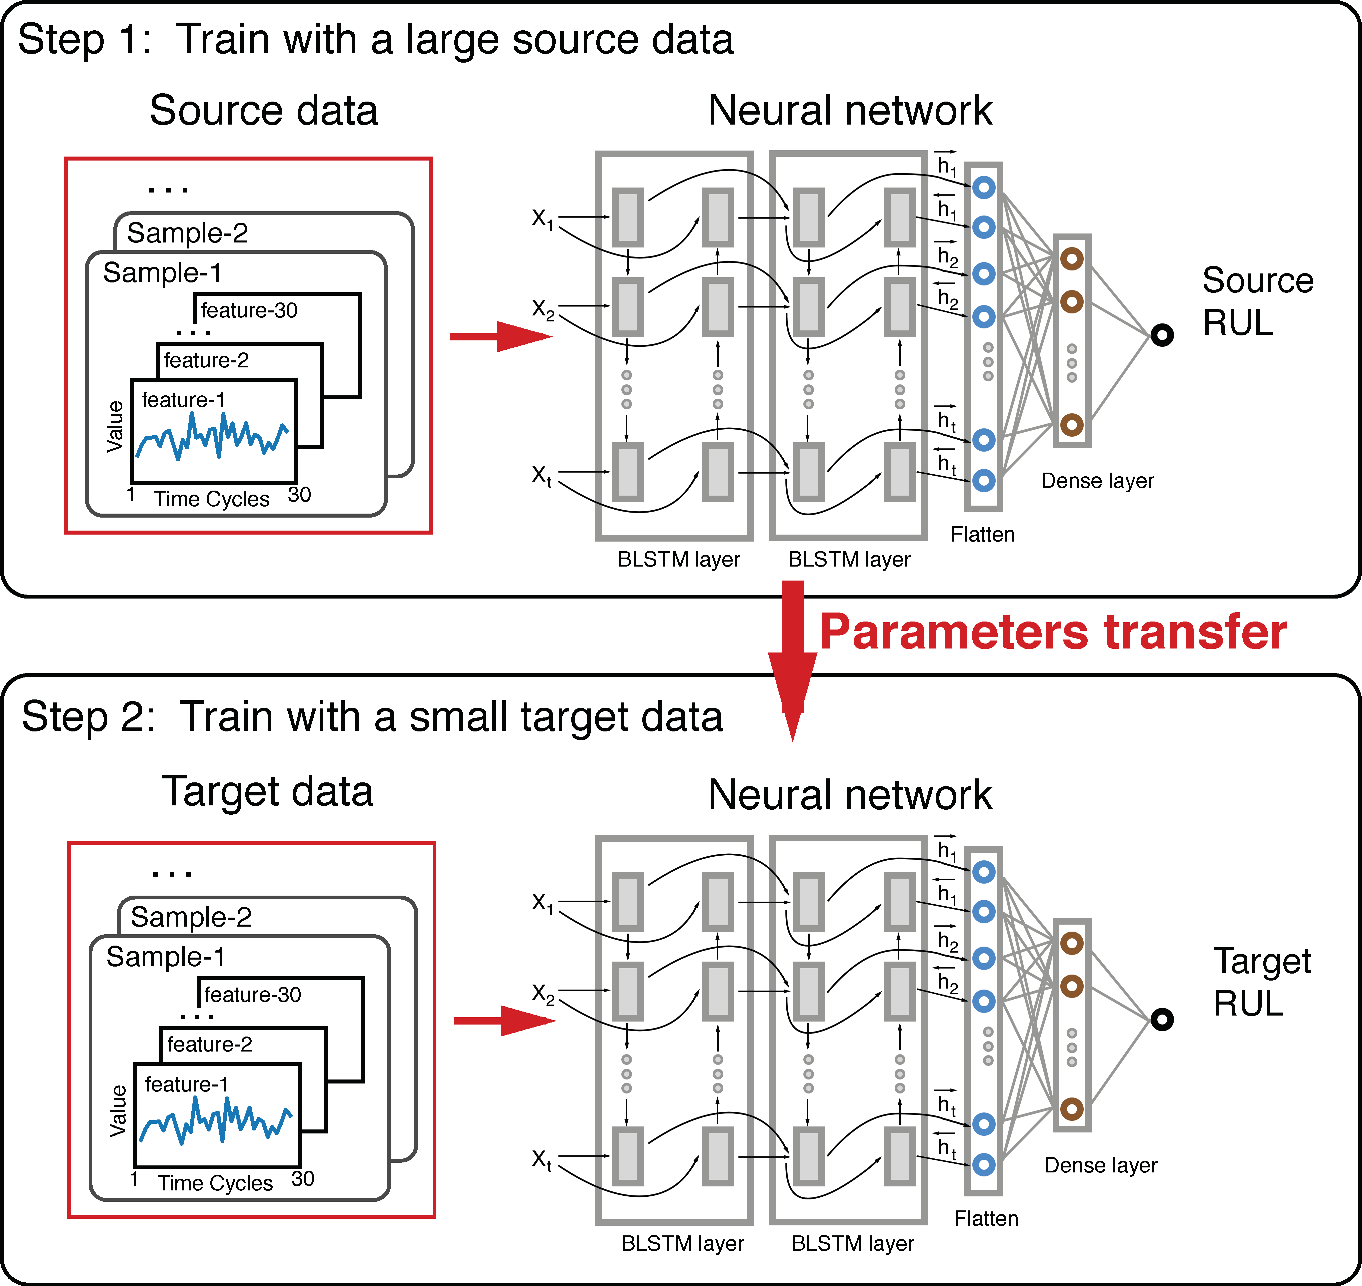
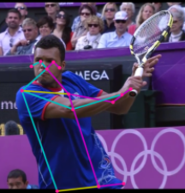
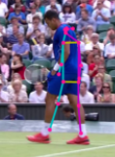
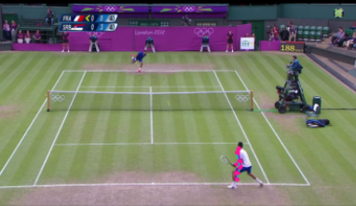
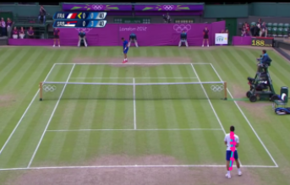
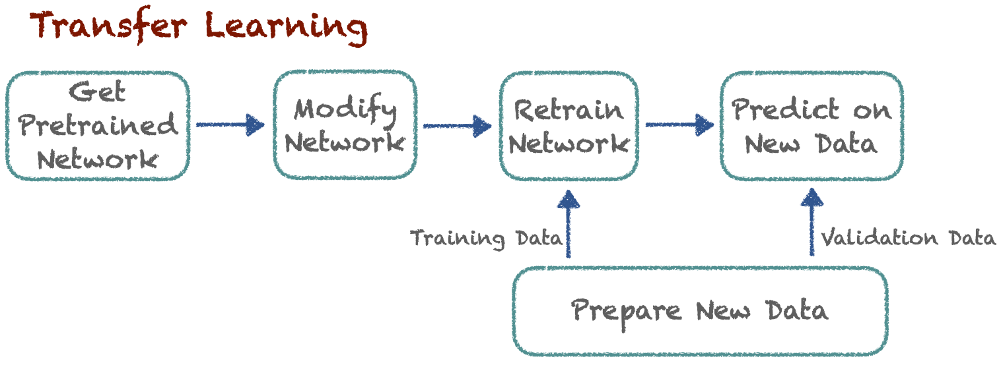
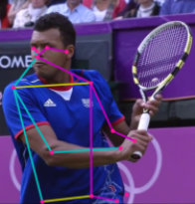
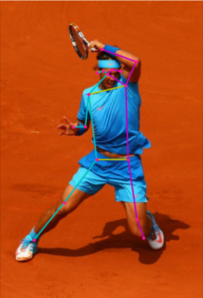
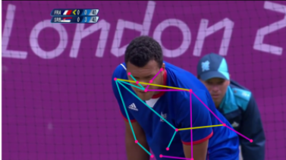
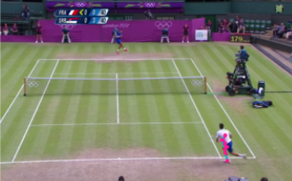
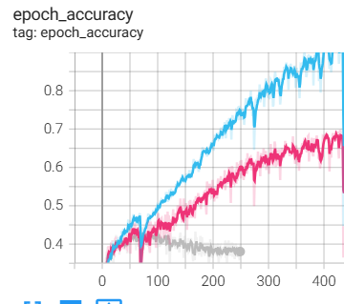
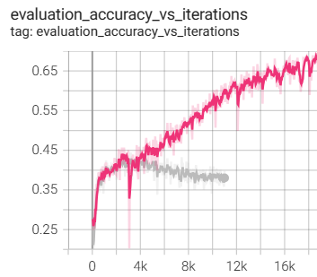
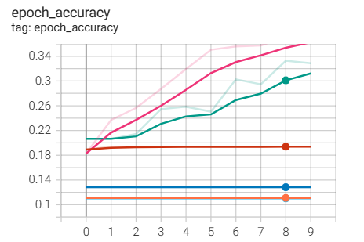
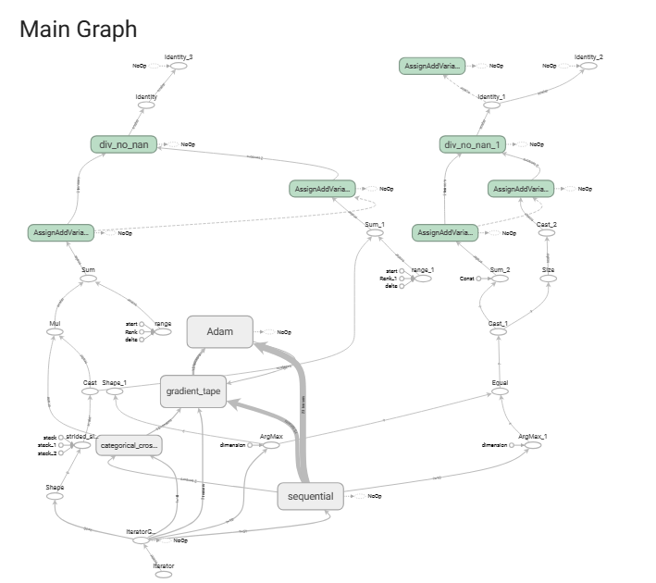
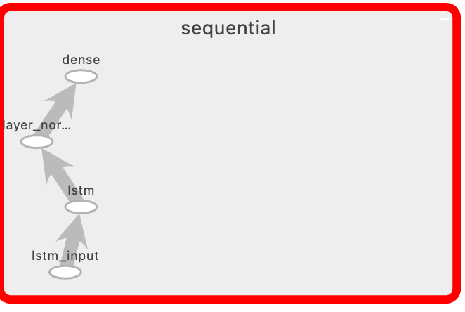
Pose Estimation and LSTM for Tennis Stroke Classification
Vanessa Bellotti and Tanay Nistala
Research Question: Can a transfer learned LSTM learn to classify tennis strokes given pose keypoints as input?
Data Understanding
Data Preprocessing
Goal: discern class imbalance in the dataset
JSON Data: Parsed through files to eliminate unnecessary features
TXT Data: Implemented output classes parsing; Pruned "Other" set for precision
Frame Filtering: Considered removing frames with multiple players. Opted against it to retain diverse interactions
Color Space Transformation: BGR to RGB conversion for MoveNet Pose estimator to enhance model robustness
Transfer Learning
Transfer learning let us capitalize on pre-existing knowledge from a model trained on a more extensive dataset, mitigating the challenge of insufficient labeled tennis-specific data.
Pose Estimation
Goal: measure preliminary results from keypoint detection
Model Selection
Model Training Pipeline and Process
Long Short-Term Memory networks excel at modeling temporal dependencies and can process variable-length sequences
LSTMs can retain contextual information over time, enabling the model to understand a tennis match’s evolving dynamics.
The ability of LSTMs to maintain a memory of previous poses is crucial for understanding transitions between stances and predicting based on player pose history.
Tennis strokes often follow distinct sequential patterns, such as the build-up to a serve or the sequence of movements in a forehand stroke.
Combining LSTMs with pose embeddings enhances the model's ability to understand both spatial and temporal aspects of tennis poses.
MoveNet Pose Detection:
Utilized MoveNet for pose detection on tennis image data.
Extracted key points representing crucial body joints in each image.
One-Hot Encoding Labels:
Defined output classes representing tennis player types of strokes.
Employed one-hot encoding to transform these categorical labels into a format suitable for neural network training.
Transfer Learning Approach:
Adopted a transfer learning strategy to capitalize on the pre-trained MoveNet model's understanding of human pose.
Leveraged the learned features and representations from MoveNet's training on a diverse dataset.
Neural Network Training:
Designed and trained a neural network to predict tennis player stance and strokes.
Transferred the knowledge gained from MoveNet's key point extraction to enhance the learning process of our specific task.
Improved Generalization:
Transfer learning enhanced the model's ability to generalize well to our tennis-specific task by leveraging knowledge from a more generalized pre-trained model.
Results
Neural Architecture
Conclusion
Contributions
Multiclass classification of tennis strokes via keypoints is possible but needs to be further finetuned
Dataset needs to be upsampled to address the “Other” issue
This work introduces a transfer learned neural network layer on top of pose estimation keypoints to learn tennis stroke classes
This work identifies highly fine-tuned classes, making the results applicable to future work like commentary generation or an automated umpire application

